Slide 1
Augmenting therapy:
Aripiprazole in clozapine resistant schizophrenia
Arjun Randhawa
LMPS Pharmacy Resident
October 2019

Slide 2
Objectives
Review the current treatment guidelines for clozapine resistant schizophrenia
Describe the evidence available comparing aripiprazole and clozapine vs clozapine and placebo
Utilize the above evidence to create a treatment plan for clozapine resistant schizophrenia in a specific patient case

Slide 3
The Patient
ID | 57 year old male (74 kg, BMI: 24.8 kg/m^2) admitted September 19th with decompensation of his schizophrenia
CC | Wants a bed as he had not slept in a few days
HPI | Paranoia: Left group home due to fear care worker was going to hurt him Auditory hallucinations of ~2800 voices in each ear saying commit suicide ?Somatic delusion: chest pain Living on the streets for 1 week Non-adherence to medications x 1 week Presents with auditory hallucinations of ~2800 voices in each ear saying commit suicide and chest pain
Allergies | NKDA
Social History | No alcohol, nicotine or illicit drug use Lives in a group home
Adherence | Compliant in group home 1 week without medications
Notes:
State the pt was having positive symptoms at home prior to being admitted to leaving the care home, also that on previous records the pt stated chest pain, which was due to “care worker” punching him in the chest

Slide 4
The Patient
PMHx | Meds PTA
Schizophrenia (diagnosed 1992) | Clozapine 225 mg po qhs
COPD | Ipratropium 20 mcg 1 puff q6h prn
Angina | No medical treatment

Slide 5
The Patient
Schizophrenia treatment Hx | Olanzapine (1999) Asenapine Quetiapine ? Aripiprazole Risperidone Clozapine (since December 2018)
Notes:
Clozapine trial, he has essentially been at the same dose of 225mg since being titrated, a past hospitalization showed that he was titrated to 250, but that caused a QTC prolongation of 500.

Slide 6
Course in Hospital
Date | Events
Sept 20th | Presented to ER Received loxapine 10 mg po and olanzapine 5 mg po for agitation Reported 2800 voices in each ear saying commit suicide Chest pain No homicidal or suicidal ideations at this time ECG: QTC 465, NSR with Right bundle branch block (RBB) Trop: WNL CRP: WNL BP: 102/73
Sept 21th | Admitted to Segal Restarted on clozapine at 12.5 mg po qhs Reported 3000 voice in each ear saying commit suicide Chest pain Chest X-ray: unremarkable
Oct 3rd | Clozapine 137.5 mg BP: 100/54 sitting, and 97/58 standing, pt reported dizziness 2900 voices in each ear saying commit suicide Chest pain
October 7th | Clozapine 200 mg BP: 101/68 sitting and 100/60 standing, pt reported dizziness 2800 voices in each ear saying commit suicide Chest pain Chest CT: unremarkable ECG: QTC 475 (RBB)

Slide 7
Review of systems (Oct 7th)
Vitals | T 36.7, HR 80,BP: 101/68 sitting and 100/60 standing, RR 18, O2 sat 98% RA
CNS | A&O x 3
Mental status examination | Appearance and behavior: Ungroomed, cooperative and pleasant Speech: Latent Affect mood: States mood is good, restricted affect Thought content: Organized Somatic delusion (chest pain) Perceptions: Auditory hallucinations of 2800 voices in each ear saying commit suicide & Cognitive function: Poor concentration Insight and Judgment: Poor insight, impaired judgement
GI | BM daily
Other body systems | Unremarkable, or not assessed

Slide 8
Labs and investigations
Relevant Diagnostics | ECG: QTC 475 RBB CT chest: unremarkable
Labs (Oct 7th) | WBC 4.0 Neut 3.0 Hgb 121 CRP: 1.6 Trop: <0.02 B₁₂: 360 TSAT: 34% LDL-C: 1.6 Total Cholesterol: 3.4 | FBG: 4.6 Na 136 K 3.9 Mg 0.6 Creatinine 58 CrCl 127ml/min

Slide 9
Current Medical Problems
Medical Problem | Drug Therapy
1. Schizophrenia | Clozapine 200 mg po qhs
2. Hypotension | No treatment

Slide 10
Drug Therapy Problems
Patient is experiencing ongoing positive symptoms (auditory hallucinations and somatic delusions) and requires reassessment of therapy
Patient is experiencing symptoms of hypotension (dizziness) and requires reassessment of therapy

Slide 11
Goals of Therapy
Prevent mortality (suicide)
Eliminate/reduce positive symptoms:
  Auditory hallucinations
  Persecutory delusions
  Somatic delusions
Prevent relapse of schizophrenia decompensation
Prevent adverse drug reactions

Slide 12
Canadian Schizophrenia Guidelines
Treatment-resistant schizophrenia: patients with schizophrenia with persistent positive and negative symptoms despite at least two adequate trials of classical neuroleptic drugs
Clozapine drug of choice
  Shown to be superior to other antipsychotics with regards to efficacy and safety
Notes:
The Canadian guidelines for Schizophrenia are developed from American guidelines and the NICE guidelines
The most common definition of treatment-resistant schizophrenia denotes patients with schizophrenia who, despite at least two adequate trials of antipsychotics (one of which must be an atypical antipsychotic), have persistent moderate to severe positive, or disorganisation, or negative symptoms together with poor social and work function over a prolonged period of time, with a trial of therapy for at least 6-8 weeks
Chakos et al. (2001) conducted a meta-analysis of 7 randomised, controlled trials comparing conventional and atypical antipsychotics. These authors concluded that clozapine was superior to conventional antipsychotics in both efficacy (as measured by improvement in overall psychopathology) and safety (in terms of extrapyramidal side effects). (Olanzapine and risperidone). Since then there have been many studies comparing clozapine to many other therapies and it has been continually been shown to be more effective

Slide 13
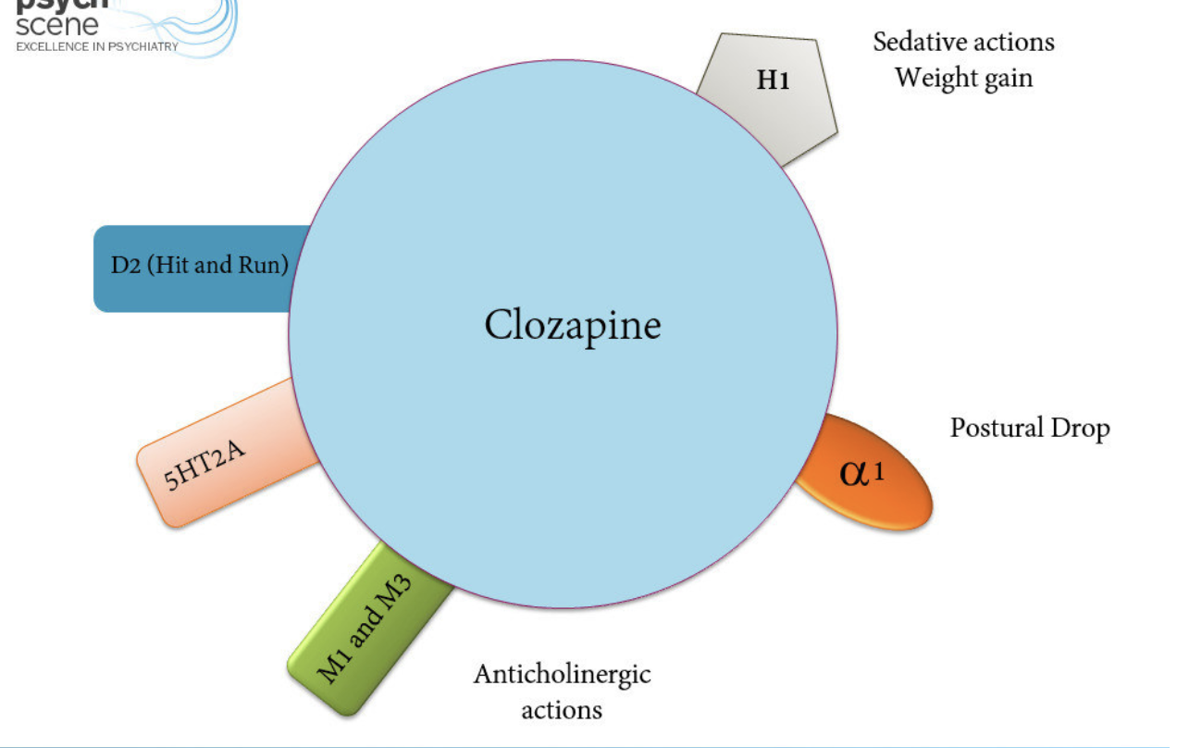
Clozapine
MOA: Blockage at the: 5-HT2a, H1, Alpha 1 and 2, and weak D₂ affinity
Dose: target of 300-400mg/day
Trough: 1070-1835 nmol/L
https://psychscenehub.com/psychinsights/clozapine-in-schizophrenia/
½ life: ~12 hours
Fitton et al. Clozapine A Review of its Pharmacological Properties, and Therapeutic Use in Schizophrenia. 1990. 40(5): 722-747
Calgary laboratory services

Slide 14
What if Clozapine Does Not Work?

Slide 15
Canadian Schizophrenia Guidelines
“No recommendation” for clozapine resistant schizophrenia
SIGN guidelines recommend augmentation with another atypical antipsychotic
Notes:
Scottish Intercollegiate Guidelines Network (SIGN)
National Institute for Health and Care Excellence (NICE)

Slide 16
Therapeutic Alternatives
Risperidone
Amisulpride
Ziprasidone
Aripiprazole
Electroconvulsive Therapy (ECT)
Cochrane. Clozapine combined with different antipsychotic drugs for treatment-resistant schizophrenia. 23 March 2017.
SIGN. Guidelines for Schizophrenia. Health Improvement Scotland. March 2013.

Slide 17
QTc prolongation
Risperidone | +
Ziprasidone | ++
Aripiprazole | +/-

Slide 18
Clinical Question
P | Patients with treatment resistant schizophrenia on clozapine with positive symptoms
I | Aripiprazole + Clozapine
C | Clozapine + Placebo
O | ↓ Positive symptoms ↓ Adverse events

Slide 19
Literature Search
PubMed, EMBASE, MEDLINE, Google Scholar, Clinicals Trials database with search terms:
  “Schizophrenia or refractory schizophrenia or treatment resistance schizophrenia + aripiprazole + clozapine + placebo”
  3 randomized controlled trials:
    Chang et al. 2008
    Fleishhacker et al. 2010
    Muscatello et al. 2011

Slide 20
Chang et al. 2008
Design/Method | 8 week randomized double blind placebo control trial of 62 adult patients (≥18 years) diagnosed with treatment resistant schizophrenia on clozapine
Inclusion | Diagnosis of schizophrenia as per DSM-IV ≥1year of Clozapine treatment ≥ 400mg/day of clozapine on a stable dose x 8 weeks unless compromised by adverse effects Brief Psychiatric Rating Scale(BPRS) score ≥ 35 Positive symptom score of 8 on 4 items of BPRS or a score of 4 on hallucinations, conceptual disorganization, unusual thought content, or suspiciousness
Exclusion | Substance dependence (not including nicotine or caffeine) Prior history of nonresponse or tolerance to Aripiprazole
Intervention | Aripiprazole 5mg with a titration to max 30mg/day + clozapine at entry dose
Comparator | Clozapine at entry dose + placebo
Outcomes | Efficacy: change in BPRS from baseline Safety: Udvalg for Kliniske Undersøgelser (UKU), Drug-Induced Extrapyramidal Symptoms Scale (DIEPSS)

Slide 21
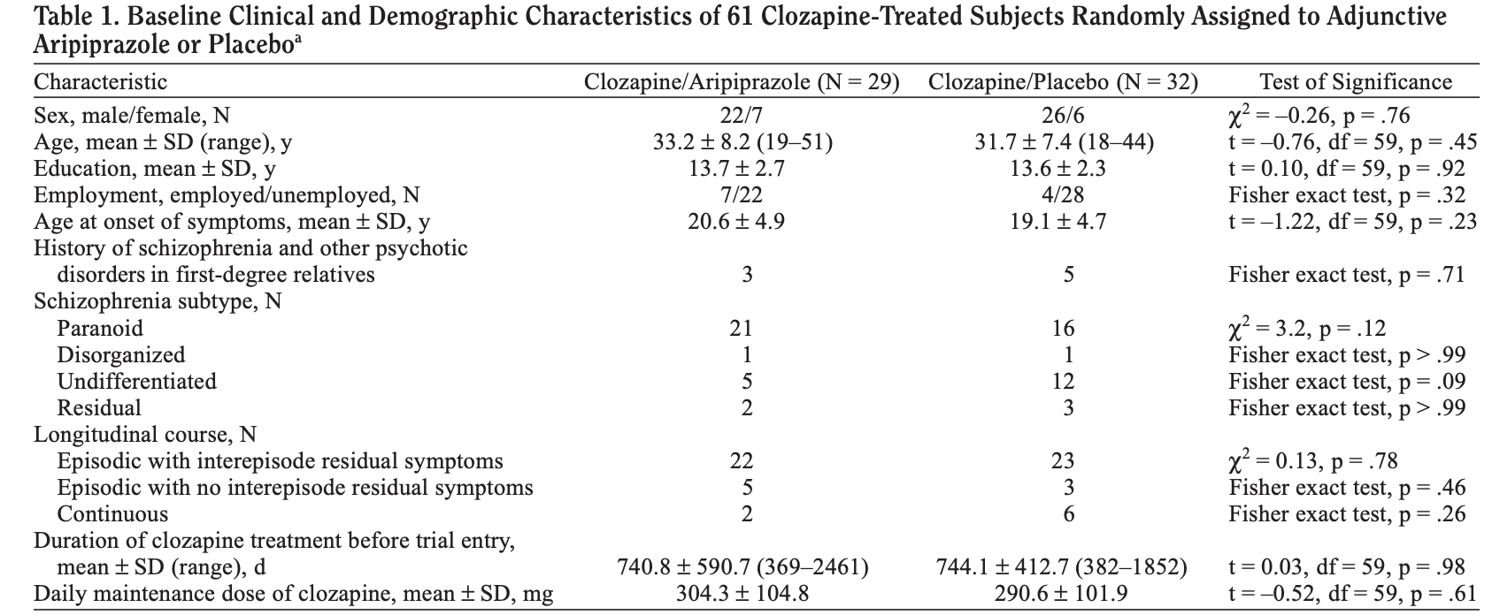
Chang et al. 2008

Slide 22
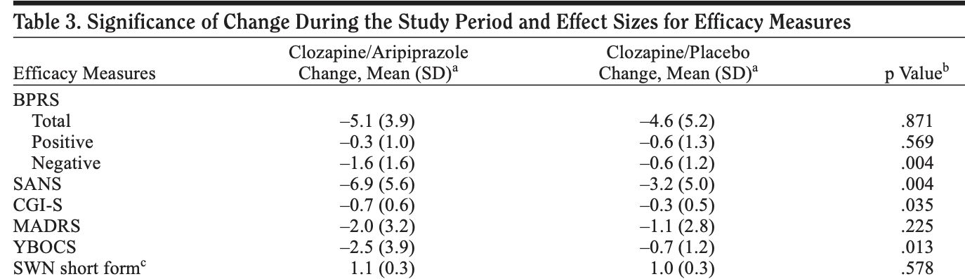
Efficacy Results

Slide 23
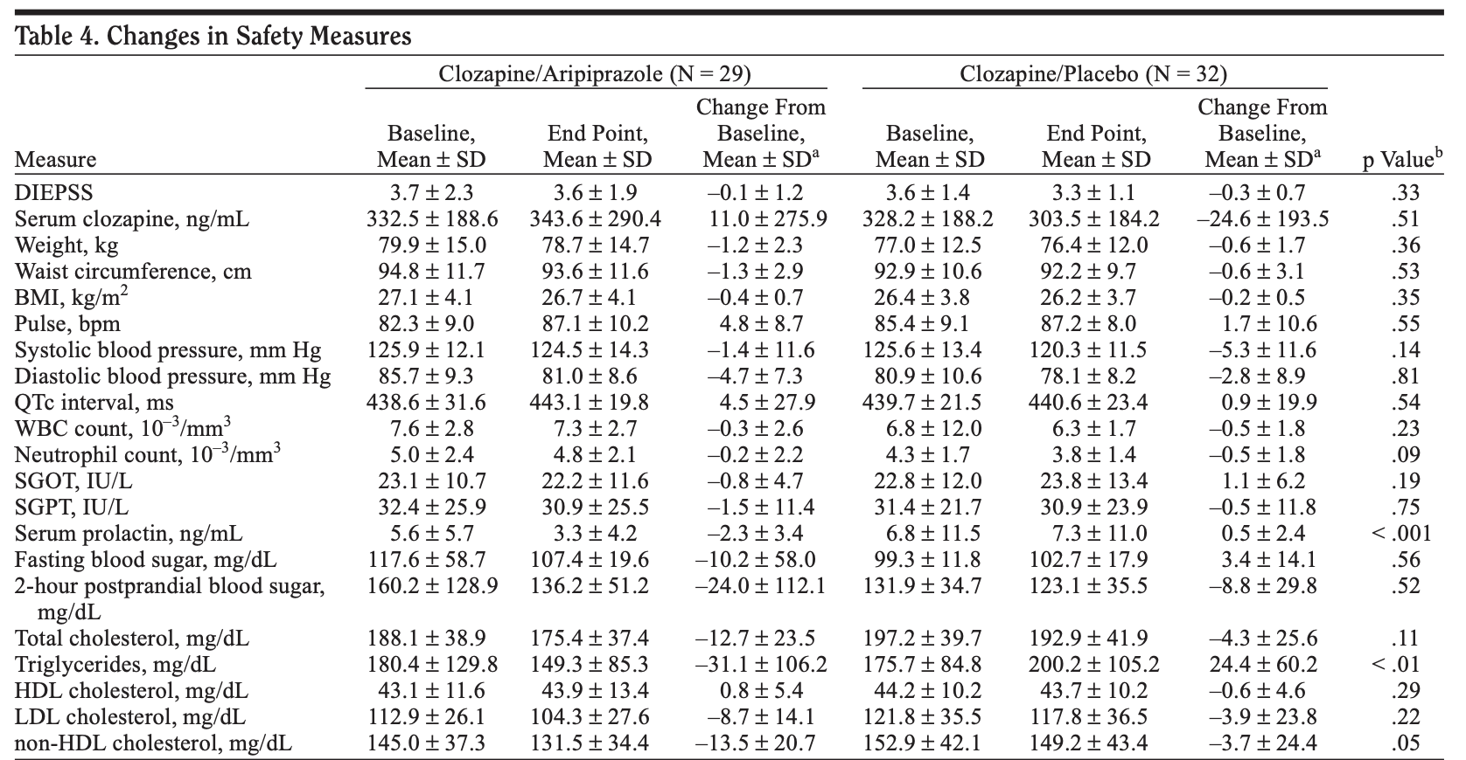
Safety Results

Slide 24
Limitations
Duration of therapy
  Beneficial effects may be seen after 8 weeks
Scoring tools up to interpretation of psychiatrist
Ethnicity of population: South Korean

Slide 25
Chang et al. 2008
Author’s conclusion:
  Aripiprazole augmentation of clozapine offers no benefit with regard to overall symptom severity in schizophrenia as compared to placebo.

Slide 26
Fleishhacker et al. 2010
Design/Method | 16 week, multicenter, randomized, double blinded, placebo-controlled trial of 207 adult patients (≥ 18 years) diagnosed with schizophrenia on clozapine for ≥ 3 months
Inclusion | 18-65 years of age Not optimally controlled on clozapine ≥ 2.5 kg weight gain on clozapine
Exclusion | Risk of suicide (suicidal ideation) Substance abuse Schizoaffective disorder
Intervention | Aripiprazole 5mg with a titration to max 15mg/day + clozapine at entry dose
Comparator | Clozapine at entry dose + placebo
Outcomes | Primary: change in body weight Secondary: Change in Positive and Negative Syndrome Scale (PANSS)

Slide 27
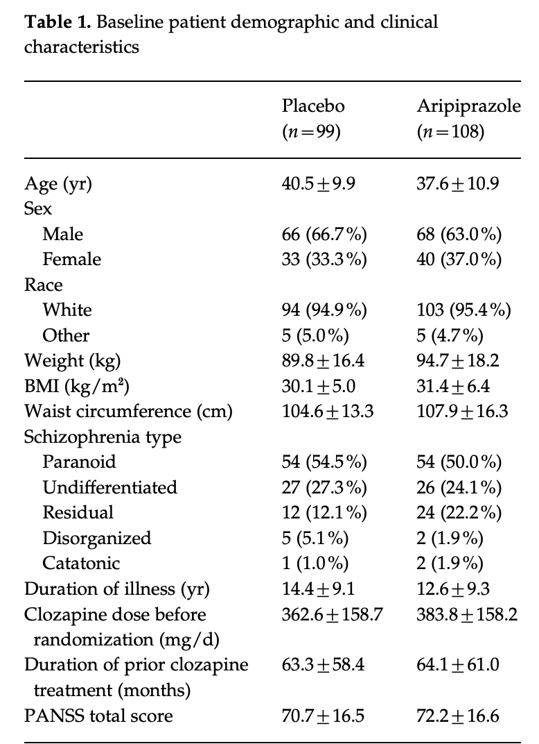
Fleishhacker et al. 2010

Slide 28
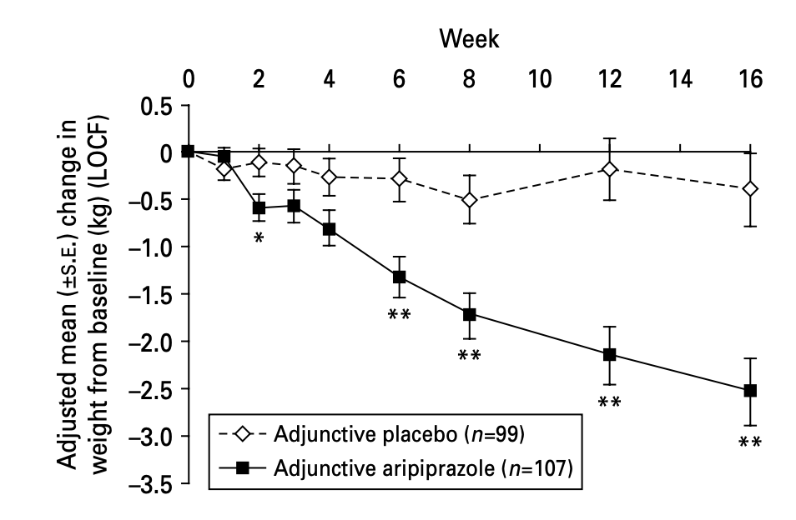
Efficacy Results
Notes:
Weight reduction at the 16 week mark -2.53 kg vs. -0.38 kg

Slide 29
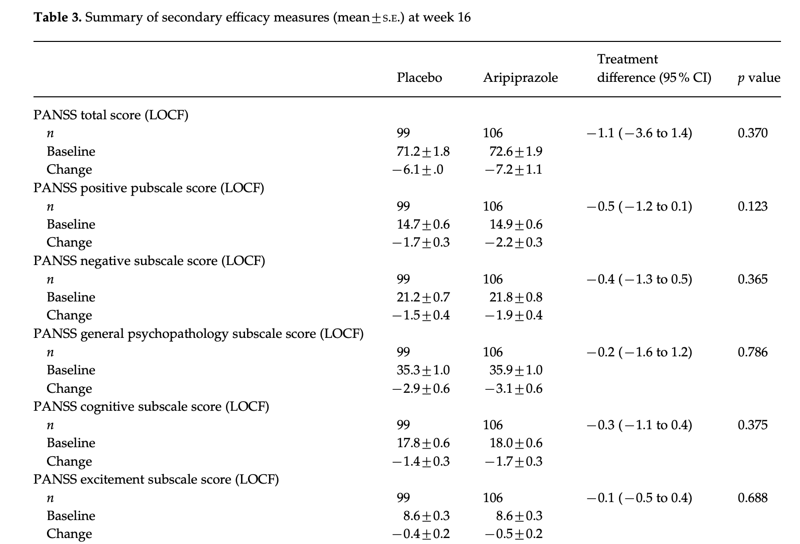
Efficacy Results

Slide 30
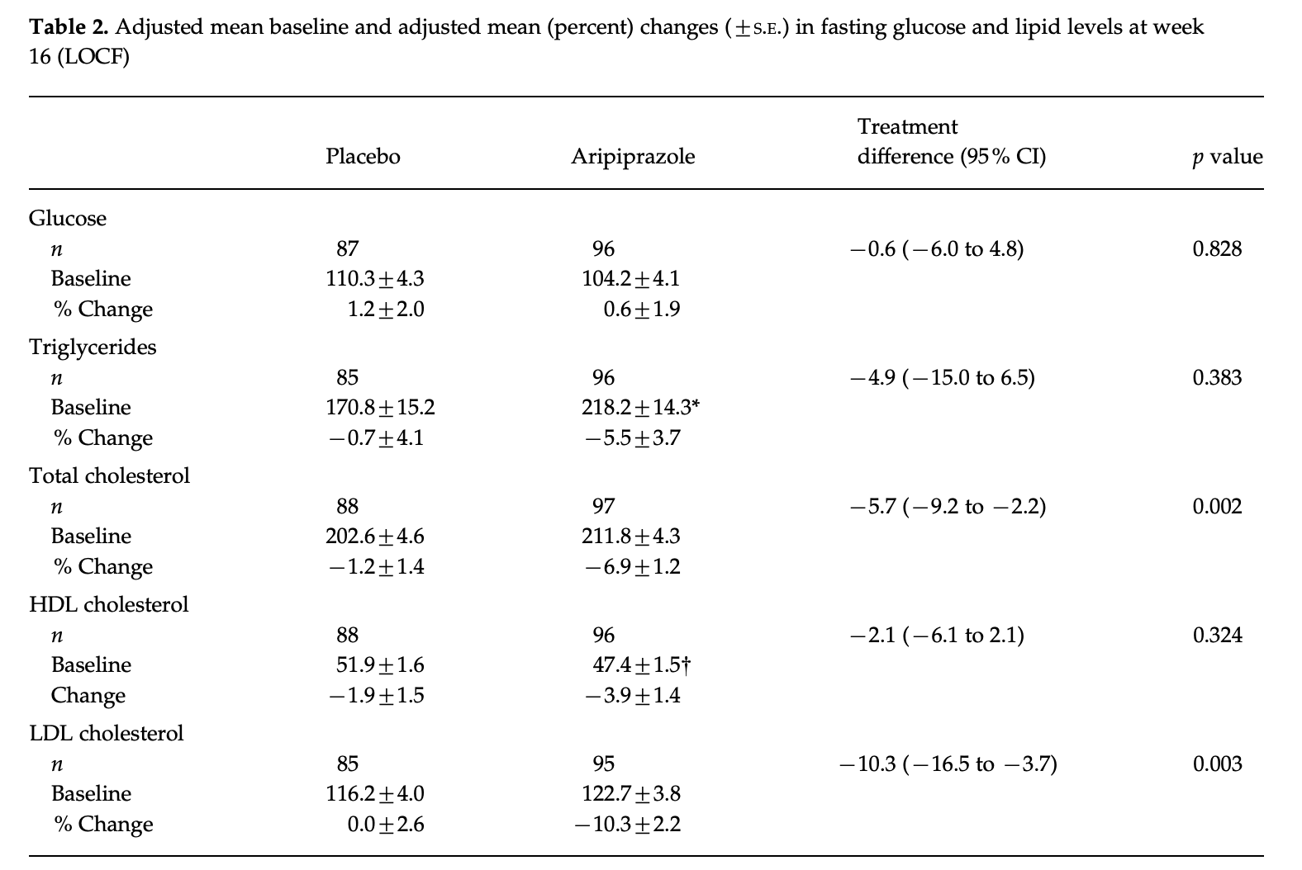
Efficacy Results

Slide 31
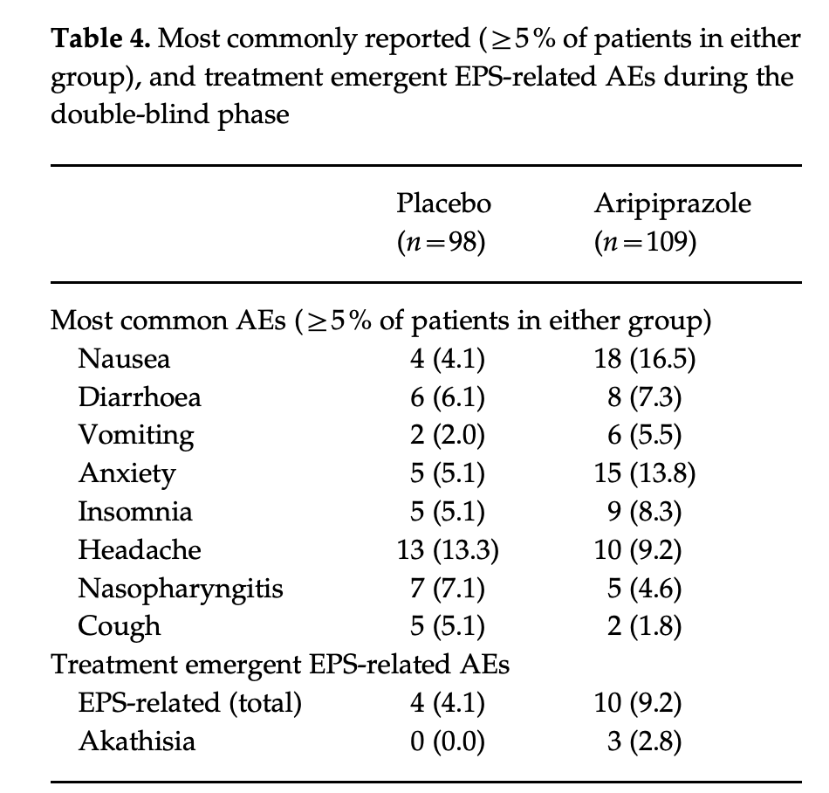
Safety Results

Slide 32
Limitations
Study not powered for efficacy results
Scoring tools up to interpretation of psychiatrist
Previous trial of aripiprazole not an exclusion criteria
Low dose of aripiprazole

Slide 33
Fleishhacker et al. 2010
Author’s conclusion:
  Combination of aripiprazole and clozapine provides benefit with regards to weight, BMI, and cholesterol, but not symptom improvement.

Slide 34
Muscatello et al. 2011
Design/Method | 24 week, randomized, double blinded, placebo-controlled trial of 40 adult patients (age 25-38 years) diagnosed with schizophrenia on clozapine with positive and negative symptoms
Inclusion | 1 year of clozapine (200-400 mg/d), stable dose x 1 month
Exclusion | Substance abuse Any other major psychiatric illness Pregnancy
Intervention | Aripiprazole 5mg with a titration to max 15mg/day + clozapine at entry dose
Comparator | Clozapine at entry dose + placebo
Outcomes | Changes from baseline in: Brief Psychiatric Rating Scale (BPRS), the Scale for the Assessment of Negative Symptoms (SANS), the Scale for the Assessment of Positive Symptoms (SAPS), and the Calgary Depression Scale for Schizophrenia (CDSS)

Slide 35
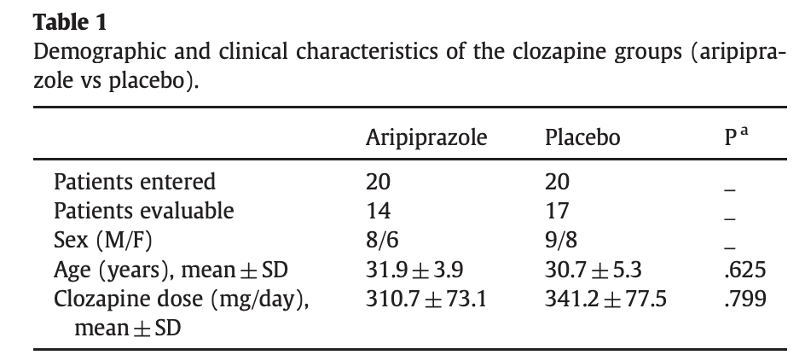
Muscatello et al. 2011

Slide 36
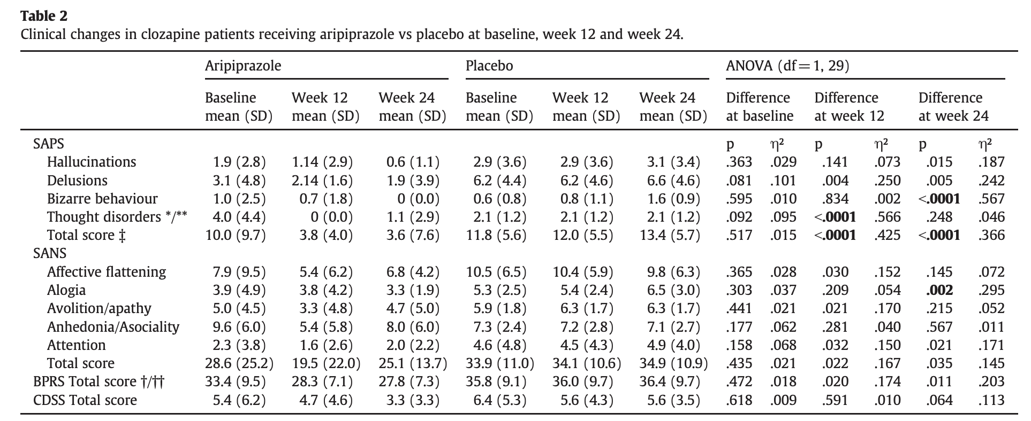
Efficacy Results

Slide 37
Limitations
Small sample size
  No mention of whether the study was powered to find a difference
Scoring tools up to interpretation of psychiatrist
Previous trial of aripiprazole not an exclusion criteria
Low dose of aripiprazole
Notes:
Low dose of arirpiprazole, increased dose may have enhanced effect more so on negative symptoms but potentially on positive symptoms

Slide 38
Muscatello et al. 2011
Author’s conclusion:
  Aripiprazole augmentation of clozapine treatment may be of benefit for patients who are partially responsive to clozapine monotherapy.

Slide 39
Back to the patient…
Considering that:
  Many limitations within the RCTs:
    Duration too short
    Dose too low
    Underpowered
  Patient has not tried aripiprazole
  Patient would like to try another medications before ECT
Plan:
  Aripiprazole 5 mg po daily
  Titrate to 30 mg po daily

Slide 40
Monitoring Plan
Parameter | Target | Frequency
Efficacy
Positive symptoms (auditory hallucinations, somatic delusions) | Resolved/decrease | > 8 weeks
Safety
ADR of Aripiprazole | CNS: Headache, sedation CVS: Tachycardia GI: Constipation, xerostomia, diarrhea Endo/metabolic: weight gain, ↑ TC, ↑ TG, ↑ LDL | Anytime
ADR of Clozapine | CNS: CVS: GI: Endo: metabolic syndrome Heme: agranulocytosis, neutropenia | Anytime

Slide 41
Questions?

Slide 42
Supplemental
Notes:
Have Screen shots of some of the tools used

Slide 43
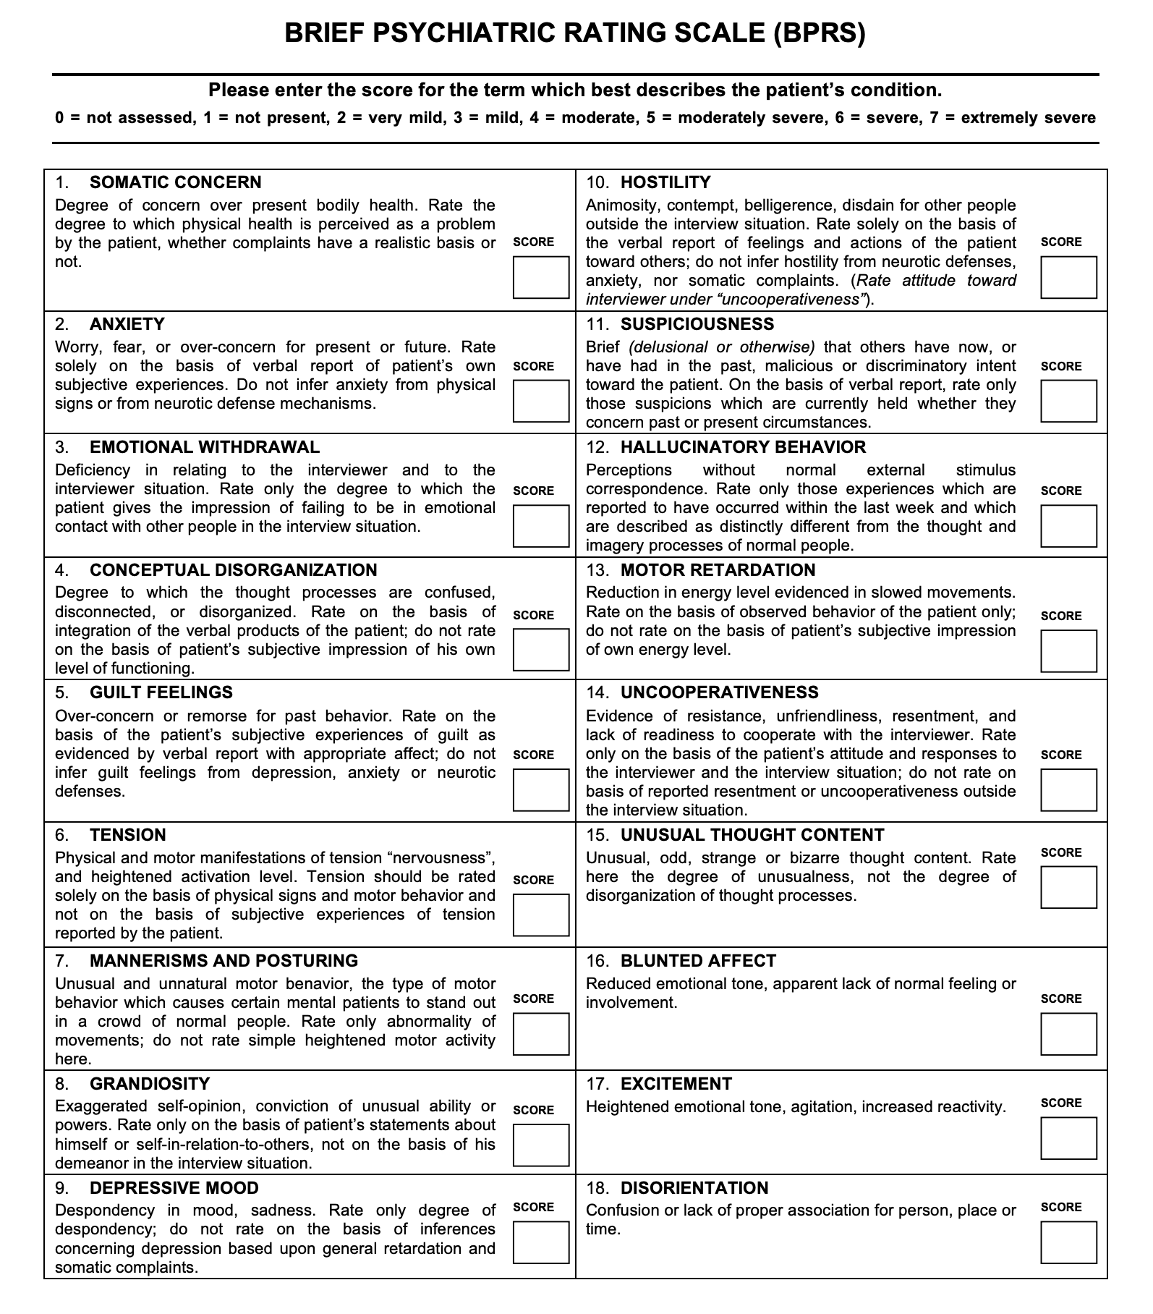

Slide 44
