Slide 1
Navigating the MAP:
Midodrine for Diuretic Resistant Ascites
Arjun Randhawa
LMPS Pharmacy Resident
September 2019

Slide 2
Objectives
Review the current treatment guidelines for ascites
Describe the evidence available comparing midodrine to standard medical therapy in alcoholic liver cirrhosis patients with ascites
Utilize the above evidence to create a treatment plan for ascites in a specific patient case

Slide 3
Definition
Refractory ascites defined as ascites that cannot be:
  mobilized
  recurrence cannot be prevented due to lack of response to:
    sodium restricted diet
    diuretic treatment (spironolactone and furosemide)
AASLD Guidelines, 2012

Slide 4
The Patient
ID | 54 y/o male (83.1kg, BMI: 28.1 kg/m^2) admitted on August 28th with ascites secondary to alcoholic liver cirrhosis
CC | Significant abdominal discomfort and pain
HPI | Discharged from Richmond Hospital in July due to ascites Paracentesis of 5L q10days
Allergies | NKDA
Social History | Heavy drinker (~½ bottle of whiskey/day since the age of 27) quit drinking on 01/01/2019
Adherence | Pt reported no cost concerns, and adherence to all medication dosing times

Slide 5
The Patient
PMHx | Meds PTA
Ascites secondary to Liver Cirrhosis (MELD 11) | Furosemide 40 mg po BID Amiloride 5 mg po daily Paracentesis 5 L/weekly Salt restriction < 2g/day
Type 2 Diabetes (A1c 4.7%) | Metformin 1000mg po BID
Gastrointestinal Esophageal Reflux Disease | Pantoprazole 40 mg po daily PRN
Insomnia | Zopiclone 7.5 mg po qhs PRN
Hemorrhoids | Citrus bioflavonoid (Venixxa®) 500mg po daily

Slide 6
Course in Hospital
Date | Events
Aug 28 | Presented to ER 10L paracentesis Albumin 25% q8h Weight: 83.7 kg BP: 112/70, MAP: 84
Aug 29 | Transferred to internal medicine Started on ceftriaxone 2 g IV Q24H for SBP Received 5L paracentesis Albumin 25% q8h Received 1 unit of RBC (Hgb 67) Salt restricted (< 2g/day) Weight: 78 kg BP 97/67 (not symptomatic), MAP: 77
Sept 2 | Paracentesis discontinued Abdominal pain subsided and Ceftriaxone stopped Spironolactone 100 mg po daily and Furosemide 40 mg po daily Weight: 72.5 kg BP: 90/52 (symptomatic), MAP: 65
Sept 3 | Weight: 74.5 kg BP: 82/46 (symptomatic), MAP: 58

Slide 7
Review of Systems (Sept 3rd)
Vitals | T 36.7, HR 80, BP 82/46, MAP: 58, RR 18, O2 sat 98% RA
CNS | A&O x 3, no encephalopathy noted
CVS | NSR, S1/S2, JVP not elevated
RESP | No wheezes or crackles, slight ↓ air entry to bases
GI | Distended abdomen, not tender to palpation
GU | Urine output: ~800 ml
ENDO | BG @ 0800 = 4.1, @ 1200 = 8.9
MSK/DERM/Fluids | No peripheral edema noted

Slide 8
Labs & Investigations
Relevant Diagnostics | Peritoneal fluid analysis (↑ neutrophils, ↑ nucleated cells) (Aug 29^{th)} Peritoneal fluid culture - negative (Aug 29th) Blood culture (no growth) (Aug 29th)
Labs (Sep 3) | WBC 4.0 Neut 3.0 Hgb 75 Lactic acid 8.8 Billi_{total}133 AST 42 A1c 4.7% B₁₂: 360 TSAT: 34% | Na 136 K 3.9 Mg 0.6 Albumin 34 Creatinine 58 GFR 110 CrCl 127ml/min

Slide 9
Current Medical Problems
Medical Problem | Drug Therapy
1. Ascites | Spironolactone 100 mg po daily + Furosemide 40 mg po daily
2. Hypomagnesemia | No drug therapy
3. T2DM | Metformin 1000 mg po BID
4. Anemia | Blood transfusions
5. Hemorrhoids | Citrus bioflavonoid (Venixxa®) 500mg po daily
6. DVT prophylaxis | Enoxaparin 40 mg sc daily
7. GERD | Pantoprazole 40 mg po daily prn
8. Insomnia | Zopiclone 7.5 mg po daily prn

Slide 10
Drug Therapy Problems
Patient is experiencing hemorrhoidal bleeds and requires reassessment of therapy
Patient is experiencing continued ascites and requires reassessment of therapy
Patient is experiencing hypotension (BP: 82/46 MAP: 58) secondary to therapy with diuretics
Patient at risk of SBP secondary to untreated ascites
Patient at risk of lactic acidosis secondary to continuation of metformin
Patient at risk of continued metformin ADRs secondary to unnecessary therapy for T2DM (A1c 4.2)
Patient is at risk of cardiac arrythmias, and coronary vasospasms secondary to no treatment for hypomagnesemia
Patient is at risk of potential increased adverse drug reactions secondary to herbal therapy for hemorrhoids

Slide 11
Goals of Therapy
Eliminate ascites
Reduce ascites volume by ~0.5 kg/day
Prevent and relieve ascites-related symptoms
Prevent spontaneous bacterial peritonitis
Minimize adverse drug reactions
AASLD Guidelines, 2012

Slide 12
Therapeutics Alternatives
Diuretics (spironolactone + furosemide)
Serial therapeutic paracentesis
Transjugular intrahepatic portosystemic shunt (TIPS)
Liver transplantation
AASLD Guidelines, 2012

Slide 13
AASLD
Limited evidence supporting the use of midodrine in refractory ascites
Theoretically convert diuretic-resistant patients back to diuretic sensitive
AASLD Guidelines, 2012

Slide 14
Clinical Question
P | Patients with diuretic resistant ascites secondary to alcoholic liver cirrhosis
I | Diuretics (spironolactone and furosemide) + Midodrine
C | Diuretics (spironolactone and furosemide)
O | Reduction in ascites ↑ MAP ↓ Weight

Slide 15
Literature Search
PubMed, EMBASE, MEDLINE, Google Scholar, Clinicals Trials database with search terms:
  “liver cirrhosis or alcoholic liver cirrhosis + ascites + diuretics + midodrine”
  1 meta-analyses
    Excluded (compared the effects of albumin vs. midodrine in ascites)
  4 RCTs
    2 excluded, 1 compared midodrine, rifaximin, and diuretic therapy to diuretic therapy in ascites, 1 compared furosemide and midodrine to furosemide and placebo.
    Singh et al. 2012
    Obiedallah et al. 2017

Slide 16
Singh et al. 2012
Design/Method | Single center, randomized, double blind, control trial of 40 adults (<70 y/o) diagnosed with refractory ascites
Inclusion | Cirrhosis with refractory or recurrent ascites
Exclusion | SBP, encephalopathy, acute renal failure, hepatorenal syndrome, GI bleed
Intervention | Standard medical therapy (low sodium diet < 2g/day, furosemide 40-160 mg/day and spironolactone 100-400 mg/day, large volume paracentesis, and intravenous albumin) + midodrine 7.5 mg po TID
Comparator | Standard medical therapy
Outcomes | Control of ascites
Journal of Hepatology Volume 56, Issue 2, February 2012, Pages 348-354

Slide 17
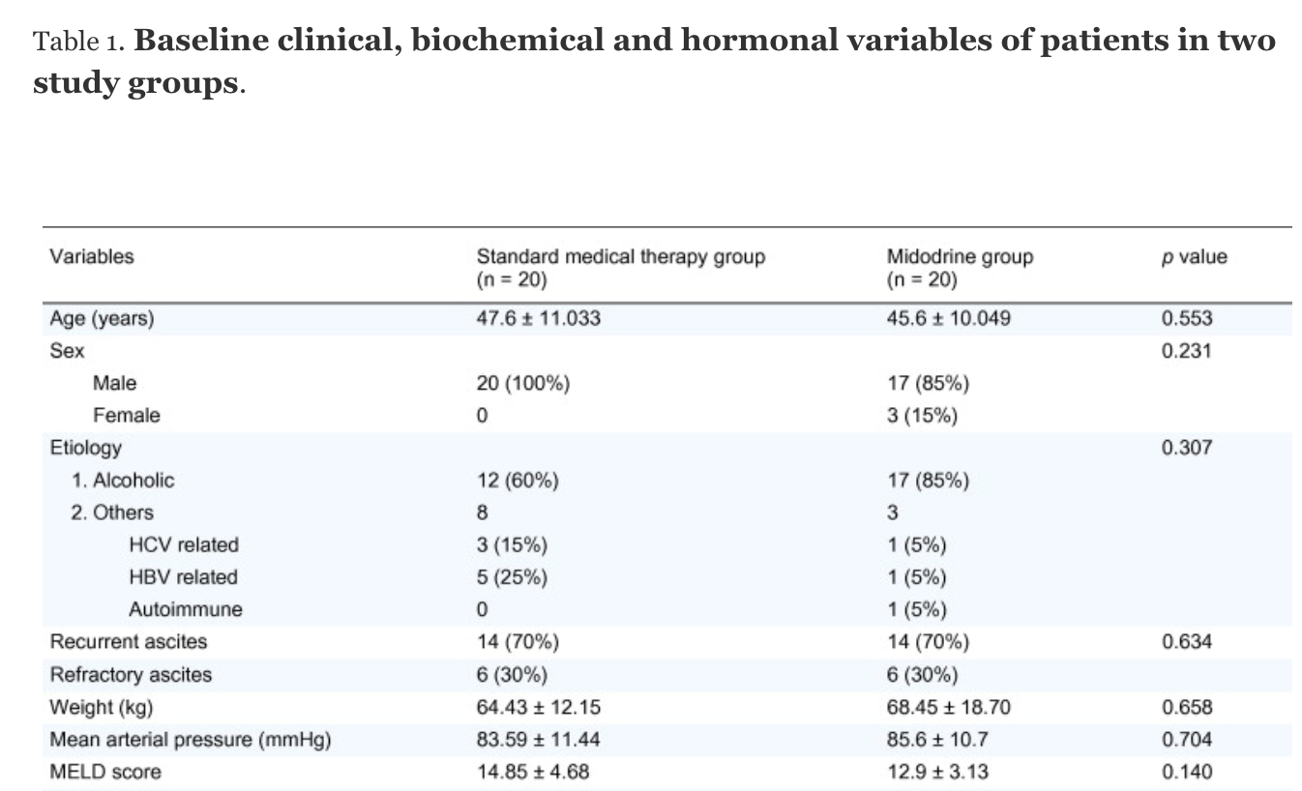
Singh et al. 2012
Journal of Hepatology Volume 56, Issue 2, February 2012, Pages 348-354

Slide 18
Efficacy Results

Slide 19
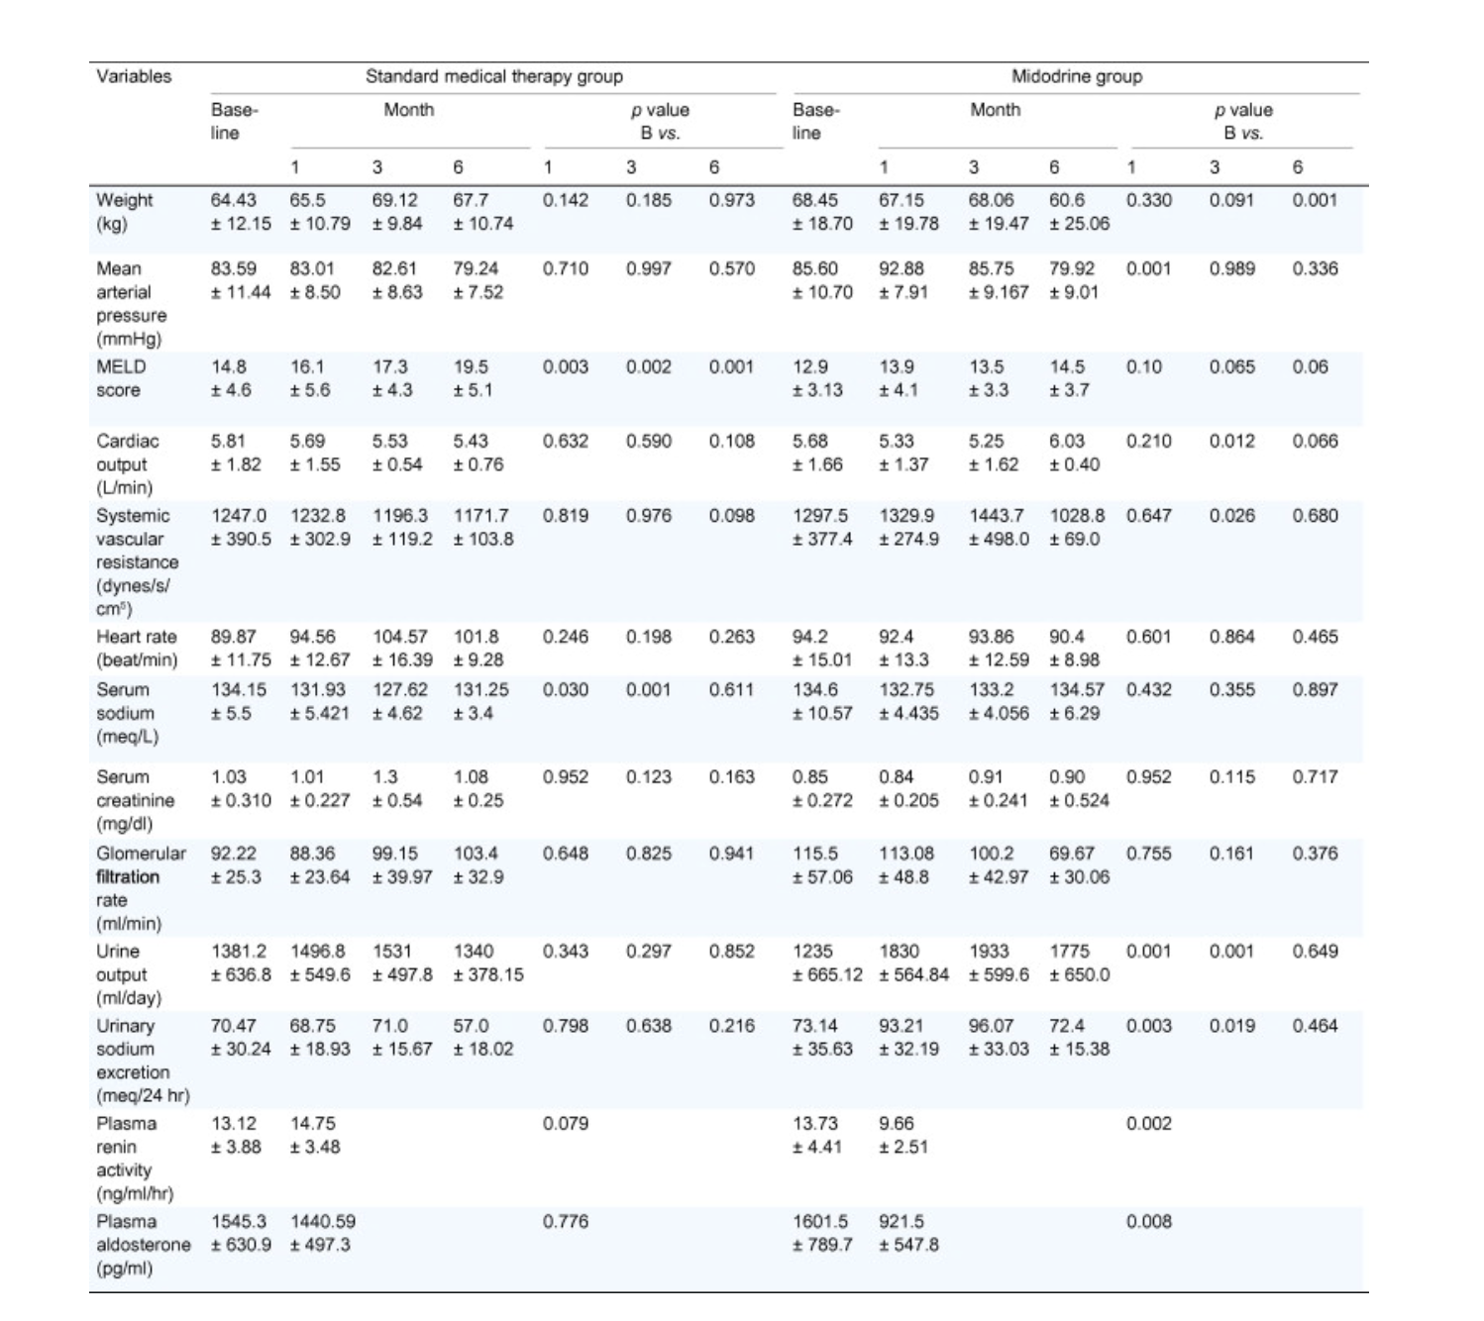
Journal of Hepatology Volume 56, Issue 2, February 2012, Pages 348-354

Slide 20
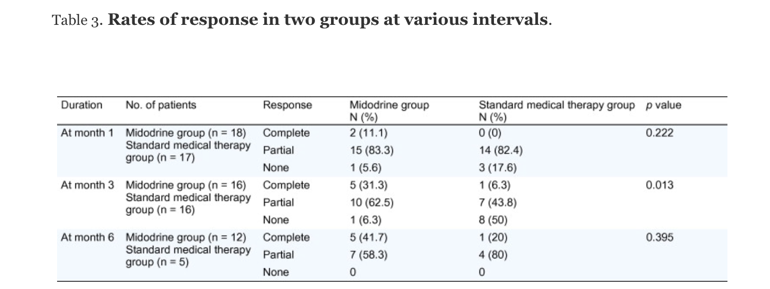
Journal of Hepatology Volume 56, Issue 2, February 2012, Pages 348-354

Slide 21
Safety Results
6 patients in the midodrine group experienced mild abdominal pain
  No other adverse drug reactions reported
Lost to follow up:
  15 in standard treatment died
  8 in midodrine treatment died
Journal of Hepatology Volume 56, Issue 2, February 2012, Pages 348-354
Notes:
upper gastrointestinal bleeding in 2, sepsis in 4, encephalopathy in 4, hepatorenal syndrome in 2, and alcoholic hepatitis in 3 patients)

Slide 22
Limitations
8 patients stopped diuretic therapy due to ADRs
Average dose of diuretics not reported
Many patients lost to follow up
Small sample size
  No mention of whether the study was powered to find a difference
Journal of Hepatology Volume 56, Issue 2, February 2012, Pages 348-354

Slide 23
Singh et al. 2012
Authors’ conclusion:
  Midodrine plus standard medical treatment better controls ascites compared with standard medical treatment alone.
My thoughts:
  Consistent outcomes not seen throughout follow-up
  Study may not be powered to detect any difference
Journal of Hepatology Volume 56, Issue 2, February 2012, Pages 348-354

Slide 24
Obiedallah et al. 2017
Design/Method | Single center, randomized control trial of 78 adults diagnosed with refractory ascites
Inclusion | Patients with liver cirrhosis and refractory ascites treated at Assiut university hospital
Exclusion | SBP, encephalopathy, acute renal failure, hepatorenal syndrome, GI bleed
Intervention | Standard medical therapy (low sodium diet, furosemide 40-160 mg/day and spironolactone 100-400 mg/day, large volume paracentesis, and intravenous albumin) + midodrine up to 15mg/day
Comparator | Standard medical therapy
Outcomes | Weight MAP Urine Output
American Journal of Internal Medicine
Volume 5, Issue 1, January 2017, Pages: 12-17

Slide 25
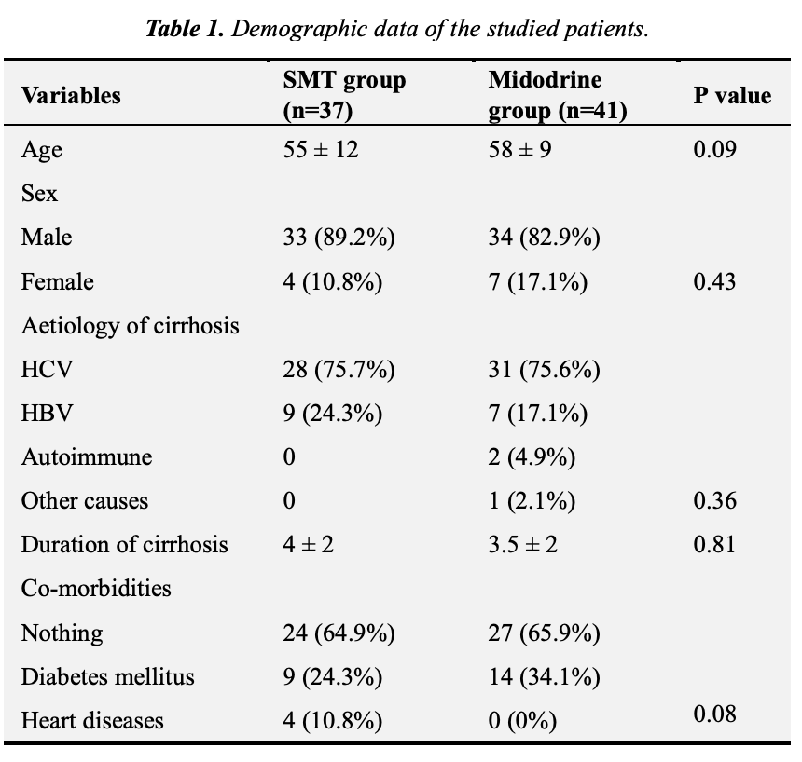
Obiedallah et al. 2017
American Journal of Internal Medicine
Volume 5, Issue 1, January 2017, Pages: 12-17

Slide 26
Efficacy Results

Slide 27
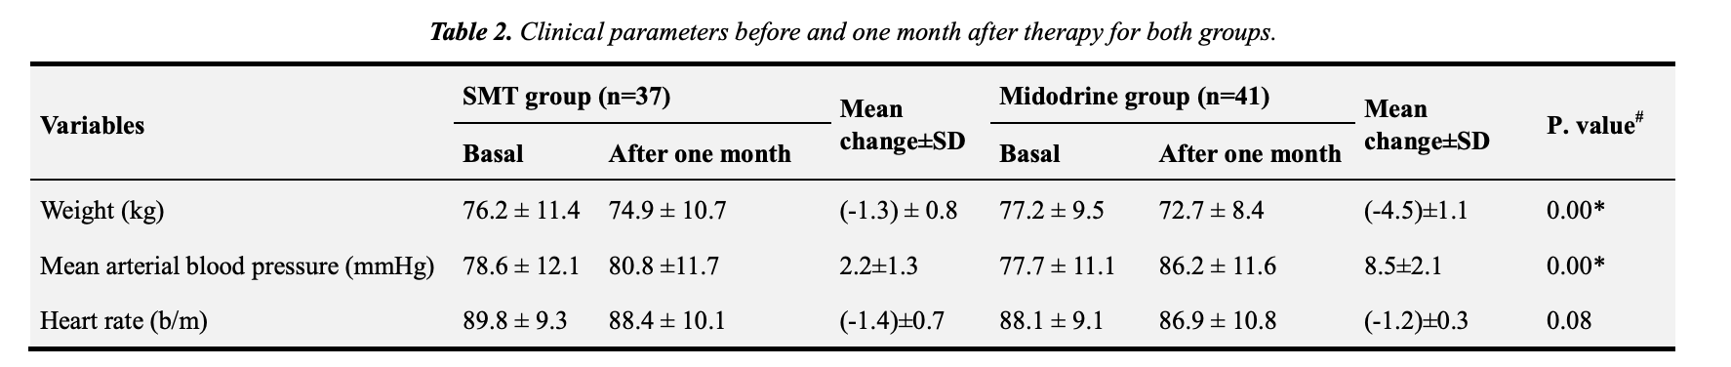
American Journal of Internal Medicine
Volume 5, Issue 1, January 2017, Pages: 12-17

Slide 28
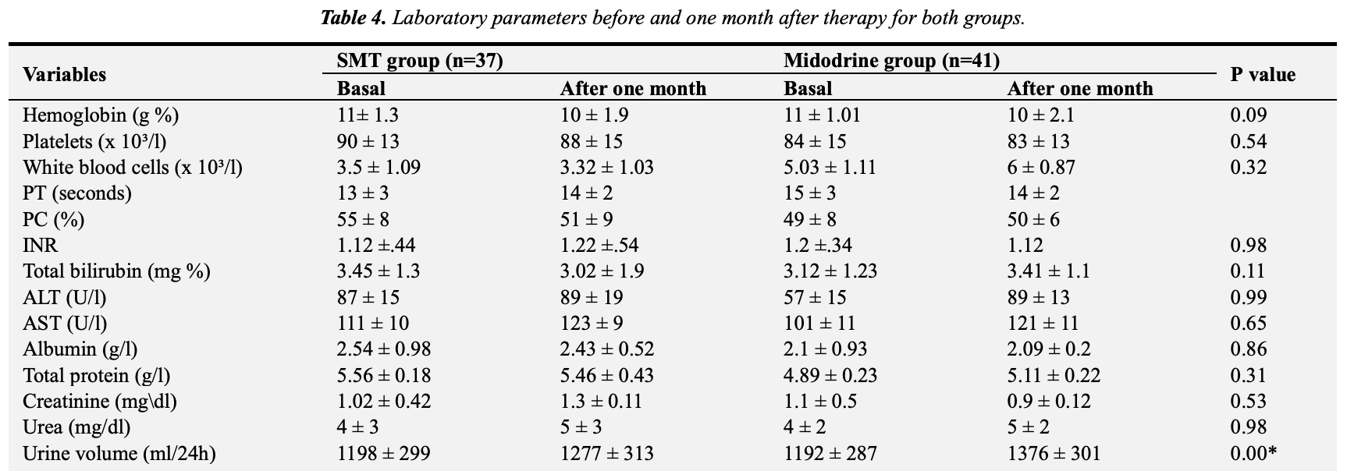
American Journal of Internal Medicine
Volume 5, Issue 1, January 2017, Pages: 12-17

Slide 29
Safety Results
Adverse drug reactions not reported
No patients expired during the 1 month follow up
American Journal of Internal Medicine
Volume 5, Issue 1, January 2017, Pages: 12-17

Slide 30
Limitations
Randomization unclear
No blinding
Adverse events not reported
Small sample size
American Journal of Internal Medicine
Volume 5, Issue 1, January 2017, Pages: 12-17

Slide 31
Obiedallah et al. 2017
Authors’ conclusion:
  Midodrine is a safe treatment for pts with liver cirrhosis and its addition to standard medical therapy is associated with better control of ascites.
My thoughts:
  Poor study design
  No information regarding ADRs
  ↑ MAP, ↑ Urine output, ↓ Weight
American Journal of Internal Medicine
Volume 5, Issue 1, January 2017, Pages: 12-17

Slide 32
Back to the patient…
Considering that:
  Both RCTs showed:
    ↑ MAP
    ↑ urine output
    ↓ weight
Plan:
  Midodrine 7.5 mg po tid
  Spironolactone 200 mg po daily + Furosemide 80 mg po daily

Slide 33
Monitoring Plan
Parameter | Target | Frequency
Efficacy
Abdominal discomfort | Resolved | Daily – ongoing
Weight | ↓ ~0.5kg/day (until ascites resolves) | Daily – ongoing
Abdominal girth | Decrease | Daily – ongoing
Safety
Blood pressure | Prevent hypotension | Daily – ongoing
Renal function (SrCr, GFR) | Normal | Daily in hospital
Electrolytes (Na, K) | No ↓ Na, No ↑ K | Daily in hospital
ADRs of midodrine | None | Daily – ongoing
ADRs of diuretics | None | Daily – ongoing

Slide 34
What happened after?
Pts BP ↑ to 97/67 (no symptoms), MAP: 77
Weight ↓ 72 kg
Increase in urine output 2L
Pt reported:
  severe itchiness
  dysuria

Slide 35
Questions?

